Slide 1
Session 23 : Android Intent II
Module 4.3 : Android

Slide 2
Learning Objectives
At the end of the session successful participants will be able to
Understand Android Bundles
Implement Intents & Bundles
Implement Activity Example

Slide 3
Android Intents
Android Activities
An activity usually presents a single visual user interface from which a number of actions could be performed.
Moving from one activity to another is accomplished by having the current activity start the next one through so called intents.
Intent
{action + data}
Activity – 1
startActivityForResul
…
onActivityResult()
…
Activity – 2
onResult()
…
…
requestCode
requestResult
[optional data]

Slide 4
Android Intents
Android Bundles
Most programming languages support the notion of IPC method-calling with arguments flowing birectionally from the caller to the invoked method.
In android the calling activity issues an invocation to another activity using an Intent object.
Note: In Android, the caller does not stop waiting for the called activity to return results. Instead a listening-method [onActivityResult(...) ] should be used.

Slide 5
Android Intents
Android Bundles
Normally the IPC expressions actual parameter list, and formal parameter listare used to designated the signature of participating arguments, and the currently supplied data.
Instead of using the traditional formal / actual parameter lists, Android relies on the concept of Intents to establish Inter-process-communication.
Intents optionally carry a named actual list or bundle for data exchange.

Slide 6
Android Intents
Android Bundles
The Android Bundle container is a simple mechanism used to pass data between activities.
A Bundle is a type-safe collection of <name, value>pairs.
There is a set of putXXX and getXXX methods to store and retrieve (single and array) values of primitive data types from/to the bundles. For example
Bundle myBundle = new Bundle();
myBundle.putDouble(“var1”, 3.1415);
...
Double v1 = myBundle.getDouble(“var1”);

Slide 7
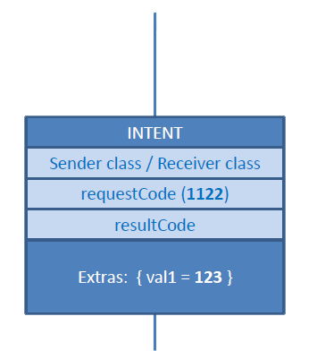

Android Intents
Android Intents & Bundles
Sender
Receiver
Activity 1
Activity 2
Intent myIntentA1A2 = new Intent (Activity1.this, Activity2.class);
Bundle myBundle1 = new Bundle();
myBundle1.putInt (“val1”, 123);
myIntentA1A2.putExtras(myBundle1);
startActivityForResult(myIntentA1A2, 1122);

Slide 8
Android Intents
Android Intents & Bundles
Sender
Receiver
Activity 1
Activity 2
Intent myLocalIntent2 = getIntent();
Bundle myBundle= myLocalIntent.getExtras();
intval1 = myBundle.getInt(“val1");

Slide 9
Android Intents
Android Intents & Bundles
Sender
Receiver
Activity 1
Activity 2
myBundle.putString("val1", 456 );
myLocalIntent.putExtras(myBundle);
setResult(Activity.RESULT_OK, myLocalIntent);

Slide 10
Android Intents
Android Bundles
Example of Public Methods
void | clear() Removes all elements from the mapping of this Bundle.
object | clone() Clones the current Bundle.
boolean | containsKey(String key) Returns true if the given key is contained in the mapping of this Bundle.
void | putIntArray(String key, int[] value) Inserts an int array value into the mapping of this Bundle, replacing any existing value for the given key.
void | putString(String key, String value) Inserts a String value into the mapping of this Bundle, replacing any existing value for the given key.

Slide 11
Android Intents
Android Bundles
Example of Public Methods
void | putStringArray(String key, String[] value) Inserts a String array value into the mapping of this Bundle, replacing any existing value for the given key.
void | putStringArrayList(String key, ArrayList<String> value) Inserts an ArrayList value into the mapping of this Bundle, replacing any existing value for the given key.
void | remove(String key) Removes any entry with the given key from the mapping of this Bundle.
int | size() Returns the number of mappings contained in this Bundle.

Slide 12
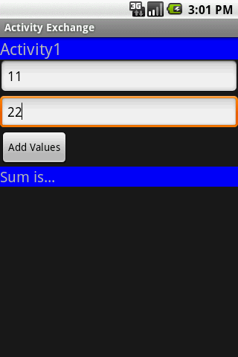
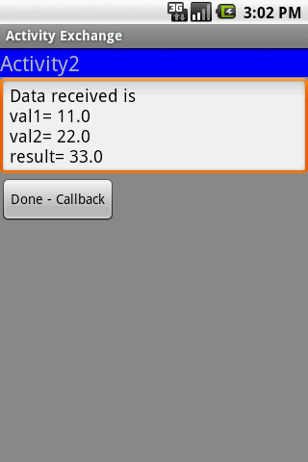
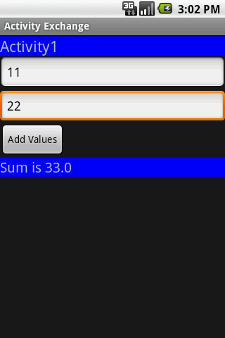
Android Intents
Tutorial: Activity Exchange
Activity-1 collects two values from its UI and calls Activity-2 to compute the sum of them. The result is sent back from Activity-2 to Activity-1.

Slide 13
Android Intents
Tutorial: Activity Exchange
Step - 1: Create GUI for Activity1 (main1.xml)
<?xml version="1.0" encoding="utf-8"?>
<LinearLayoutxmlns:android="http://schemas.android.com/apk/res/android"
android:orientation="vertical" android:layout_width="fill_parent"
android:layout_height="fill_parent" >
<TextView
android:text="Activity1"
android:textSize="22sp"
android:background="#ff0000ff"
android:layout_width="fill_parent"
android:layout_height="wrap_content" />
Note: The element android:inputStyle indicates the first value could be numeric, with optional decimals and sign.

Slide 14
Android Intents
Tutorial: Activity Exchange
Step - 1: Create GUI for Activity1 (main1.xml)
<EditText
android:hint="Enter first value (a signed double)"
android:id="@+id/EditText01"
android:layout_width="fill_parent"
android:layout_height="wrap_content"
android:inputType="numberDecimal|numberSigned|number" />
<EditText
android:hint="Second value (a positive integer)"
android:id="@+id/EditText02”
Note: The element android:inputStyle indicates the first value could be numeric, with optional decimals and sign.

Slide 15
Android Intents
Tutorial: Activity Exchange
Step - 1: Create GUI for Activity1 (main1.xml)
android:layout_width="fill_parent"
android:layout_height="wrap_content"
android:inputType="number" />
<Button
android:text="Add Values"
android:id="@+id/btnAdd"
android:layout_width="wrap_content"
android:layout_height="wrap_content" />
<TextView
android:background="#ff0000ff"
android:text="Sum is..."
android:textSize="28sp”
Note: The element android:inputStyle indicates the first value could be numeric, with optional decimals and sign.

Slide 16
Android Intents
Tutorial: Activity Exchange
Step - 1: Create GUI for Activity1 (main1.xml)
android:id="@+id/TextView01"
android:layout_width="fill_parent"
android:layout_height="wrap_content" />
</LinearLayout>
Note: The element android:inputStyle indicates the first value could be numeric, with optional decimals and sign.

Slide 17
Android Intents
Tutorial: Activity Exchange
Step - 2: Create GUI for Activity2 (main2.xml)
<?xml version="1.0" encoding="utf-8"?>
<LinearLayoutxmlns:android="http://schemas.android.com/apk/res/android"
android:orientation="vertical"
android:layout_width="fill_parent"
android:layout_height="fill_parent"
android:background="#ff888888">
<TextView
android:text="Activity2"
android:textSize="22sp"
android:background="#ff0000ff"
android:layout_width="fill_parent”

Slide 18
Android Intents
Tutorial: Activity Exchange
Step - 2: Create GUI for Activity2 (main2.xml)
android:layout_height="wrap_content" />
<EditText
android:text="Data reveived..."
android:id="@+id/etDataReceived"
android:layout_width="fill_parent"
android:layout_height="wrap_content" />
<Button
android:text="Done -Callback"
android:id="@+id/btnDone"
android:layout_width="wrap_content"
android:layout_height="wrap_content" />
</LinearLayout>

Slide 19
Android Intents
Tutorial: Activity Exchange
Step - 3: Activity 1. After clicking the button data, from UI is put in a bundle and sent to Activity 2. A listener remains alert waiting for results to come from the called activity.
packagecis493.matos.intents6;
// Activity1
// get input data from user, call Activity2, show result
importandroid.app.Activity;
importandroid.content.Intent;
importandroid.os.Bundle;
importandroid.view.View;
importandroid.view.View.OnClickListener;
importandroid.widget.Button;
importandroid.widget.EditText;

Slide 20
Android Intents
Tutorial: Activity Exchange
Step - 3: Activity 1. After clicking the button data, from UI is put in a bundle and sent to Activity 2. A listener remains alert waiting for results to come from the called activity.
import android.widget.TextView;
public classActivity1 extendsActivity {
EditTexttxtVal1;
EditTexttxtVal2;
TextViewlblResult;
Button btnAdd;
@Override
public void onCreate(Bundle savedInstanceState) {
super.onCreate(savedInstanceState);
setContentView(R.layout.main1);

Slide 21
Android Intents
Tutorial: Activity Exchange
Step - 3: Activity 1. After clicking the button data, from UI is put in a bundle and sent to Activity 2. A listener remains alert waiting for results to come from the called activity.
txtVal1= (EditText)findViewById(R.id.EditText01);
txtVal2= (EditText)findViewById(R.id.EditText02);
lblResult= (TextView) findViewById(R.id.TextView01);
btnAdd= (Button) findViewById(R.id.btnAdd);
btnAdd.setOnClickListener(newOnClickListener() {
@Override
publicvoidonClick(View v) {
// get values from the UI
Double v1 = Double.parseDouble(txtVal1.getText().toString());

Slide 22
Android Intents
Tutorial: Activity Exchange
Step - 3: Activity 1. After clicking the button data, from UI is put in a bundle and sent to Activity 2. A listener remains alert waiting for results to come from the called activity.
Double v2 = Double.parseDouble(txtVal2.getText().toString());
// create intent to call Activity2
Intent myIntentA1A2 = newIntent (Activity1.this,
Activity2.class);
// create a container to ship data
Bundle myData= newBundle();
// add <key,value> data items to the container
myData.putDouble("val1", v1);
myData.putDouble("val2", v2);
// attach the container to the intent

Slide 23
Android Intents
Tutorial: Activity Exchange
Step - 3: Activity 1. After clicking the button data, from UI is put in a bundle and sent to Activity 2. A listener remains alert waiting for results to come from the called activity.
myIntentA1A2.putExtras(myData);
// call Activity2, tell your local listener to wait response
startActivityForResult(myIntentA1A2, 101);
}//onClick
});
}//onCreate
///////////////////////////////////////////////////////////////////// local listener receiving callbacks from other activities
@Override
protectedvoidonActivityResult(intrequestCode,

Slide 24
Android Intents
Tutorial: Activity Exchange
Step - 3: Activity 1. After clicking the button data, from UI is put in a bundle and sent to Activity 2. A listener remains alert waiting for results to come from the called activity.
intresultCode, Intent data) {
super.onActivityResult(requestCode, resultCode, data);
try{
if((requestCode== 101 ) && (resultCode== Activity.RESULT_OK)){
Bundle myResults= data.getExtras();
Double vresult= myResults.getDouble("vresult");
lblResult.setText("Sum is "+ vresult);
}
}
catch(Exception e) {

Slide 25
Android Intents
Tutorial: Activity Exchange
Step - 3: Activity 1. After clicking the button data, from UI is put in a bundle and sent to Activity 2. A listener remains alert waiting for results to come from the called activity.
lblResult.setText("Oops! -" + requestCode+ " "+ resultCode);
}
}//onActivityResult
}//Activity1

Slide 26
Android Intents
Tutorial: Activity Exchange
Step - 4: Activity 2, Called from Activity 1, Extracts input data from the bundle attached to the intent. Performs local computation. Adds result to bundle. Returns OK signal.
package cis493.matos.intents6;
import android.app.Activity;
import android.content.Intent;
import android.os.Bundle;
import android.view.View;
import android.view.View.OnClickListener;
import android.widget.Button;
import android.widget.EditText;
public classActivity2 extendsActivity
implementsOnClickListener{

Slide 27
Android Intents
Tutorial: Activity Exchange
Step - 4: Activity 2, Called from Activity 1, Extracts input data from the bundle attached to the intent. Performs local computation. Adds result to bundle. Returns OK signal.
EditTextdataReceived;
Button btnDone;
@Override
protected void onsuper.onCreate(savedInstanceState);
setContentView(R.layout.main2);
dataReceived= (EditText) findViewById(R.id.etDataReceived);
btnDone= (Button) findViewById(R.id.btnDone);
btnDone.setOnClickListener(this);
Create(Bundle savedInstanceState) {
// pick call made to Activity2 via Intent

Slide 28
Android Intents
Tutorial: Activity Exchange
Step - 4: Activity 2, Called from Activity 1, Extracts input data from the bundle attached to the intent. Performs local computation. Adds result to bundle. Returns OK signal.
Intent myLocalIntent= getIntent();
// look into the bundle sent to Activity2 for data items
Bundle myBundle= myLocalIntent.getExtras();
Double v1 = myBundle.getDouble("val1");
Double v2 = myBundle.getDouble("val2");
// operate on the input data
Double vResult= v1 + v2;
// for illustration purposes. show data received & result
dataReceived.setText("Data received is \n"
+ "val1= "+ v1 + "\nval2= "+ v2

Slide 29
Android Intents
Tutorial: Activity Exchange
Step - 4: Activity 2, Called from Activity 1, Extracts input data from the bundle attached to the intent. Performs local computation. Adds result to bundle. Returns OK signal.
+ "\n\nresult= "+ vResult);
// add to the bundle the computed result
myBundle.putDouble("vresult", vResult);
// attach updated bumble to invoking intent
myLocalIntent.putExtras(myBundle);
// return sending an OK signal to calling activity
setResult(Activity.RESULT_OK, myLocalIntent);
}//onCreate
@Override
publicvoidonClick(View v) {

Slide 30
Android Intents
Tutorial: Activity Exchange
Step - 4: Activity 2, Called from Activity 1, Extracts input data from the bundle attached to the intent. Performs local computation. Adds result to bundle. Returns OK signal.
// close current screen -terminate Activity2
finish();
}//onClick
}//Activity2

Slide 31
Android Intents
Tutorial: Activity Exchange
Step - 5: Update the application‘s manifest. Add new <activity> tag for "Activity 2"
<?xml version="1.0" encoding="utf-8"?>
<manifest xmlns:android="http://schemas.android.com/apk/res/android"
package="cis493.matos.intents6"
android:versionCode="1"
android:versionName="1.0">
<application android:icon="@drawable/icon" android:label="@string/app_name">
<activity android:name=".Activity1"
android:label="@string/app_name">
<intent-filter>
<action android:name="android.intent.action.MAIN" />

Slide 32
Android Intents
Tutorial: Activity Exchange
Step - 5: Update the application‘s manifest. Add new <activity> tag for "Activity 2"
<category android:name="android.intent.category.LAUNCHER" />
</intent-filter>
</activity>
<activity
android:name=".Activity2">
</activity>
</application>
<uses-sdkandroid:minSdkVersion="4" />
</manifest>

Slide 33
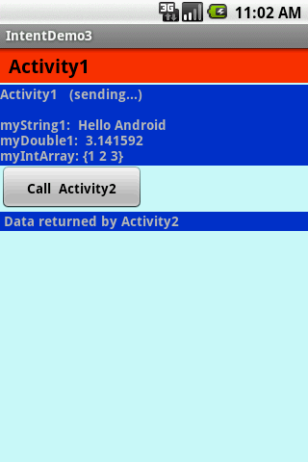
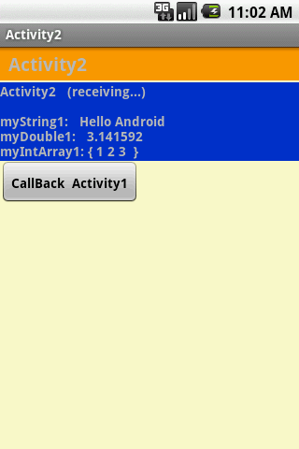
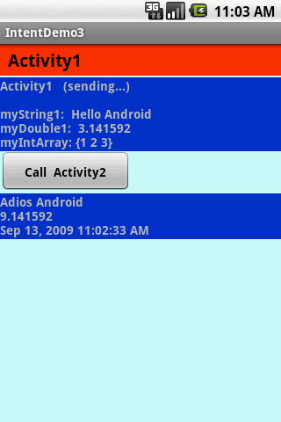
Android Intents
Tutorial: Activity Exchange
Example: Activity 1 invokes Activity 2 using an Intent. A bundle containing a set of values is sent back-and-forth between both activities.

Slide 34
Android Intents
Tutorial: Activity Exchange
Example: Activity 1 invokes Activity 2 using an Intent. A bundle containing a set of values is sent back-and-forth between both activities.
//Activity1: Invoking a user-defined sub-activity
//sending and receiving results from the sub-activity
package cis493.intents;
import android.app.Activity;
import android.content.Intent;
import android.os.Bundle;
import android.view.View;
import android.view.View.OnClickListener;
import android.widget.*;
public class Activity1 extendsActivity {

Slide 35
Android Intents
Tutorial: Activity Exchange
Example: Activity 1 invokes Activity 2 using an Intent. A bundle containing a set of values is sent back-and-forth between both activities.
TextViewlabel1;
TextViewlabel1Returned;
Button btnCallActivity2;
privatefinalintIPC_ID = 1122;
@Override
publicvoidonCreate(Bundle savedInstanceState) {
super.onCreate(savedInstanceState);
try{
setContentView(R.layout.main);
label1 = (TextView) findViewById(R.id.label1);

Slide 36
Android Intents
Tutorial: Activity Exchange
Example: Activity 1 invokes Activity 2 using an Intent. A bundle containing a set of values is sent back-and-forth between both activities.
label1Returned = (TextView) findViewById(R.id.label1Returned);
btnCallActivity2 = (Button) findViewById(R.id.btnCallActivity2);
btnCallActivity2.setOnClickListener(newClicker1());
// for demonstration purposes-show in top label
label1.setText("Activity1 (sending...) \n\n"
+ "myString1: Hello Android" + "\n"
+ "myDouble1: 3.141592 " + "\n"
+ "myIntArray: {1 2 3} ");
} catch(Exception e) {

Slide 37
Android Intents
Tutorial: Activity Exchange
Example: Activity 1 invokes Activity 2 using an Intent. A bundle containing a set of values is sent back-and-forth between both activities.
Toast.makeText(getBaseContext(),
e.getMessage(), Toast.LENGTH_LONG).show();
}
}// onCreate
Private class Clicker1 implements OnClickListener{
@Override
public void onClick(View v) {
try{
// create an Intent to talk to Activity2
Intent myIntentA1A2 = newIntent(Activity1.this, Activity2.class);

Slide 38
Android Intents
Tutorial: Activity Exchange
Example: Activity 1 invokes Activity 2 using an Intent. A bundle containing a set of values is sent back-and-forth between both activities.
// prepare a Bundle and add the data pieces to be sent
Bundle myData= newBundle();
myData.putString("myString1", "Hello Android");
myData.putDouble("myDouble1", 3.141592);
int[] myLittleArray= { 1, 2, 3 };
myData.putIntArray("myIntArray1", myLittleArray);
// bind the Bundle and the Intent that talks to Activity2
myIntentA1A2.putExtras(myData);
// call Activity2 and wait for results
startActivityForResult(myIntentA1A2, IPC_ID);

Slide 39
Android Intents
Tutorial: Activity Exchange
Example: Activity 1 invokes Activity 2 using an Intent. A bundle containing a set of values is sent back-and-forth between both activities.
} catch(Exception e) {
Toast.makeText(getBaseContext(), e.getMessage(),Toast.LENGTH_LONG).show();
}
}// onClick
}// Clicker1
@Override
protected void onActivityResult(intrequestCode, intresultCode, Intent data) {
super.onActivityResult(requestCode, resultCode, data);
try{

Slide 40
Android Intents
Tutorial: Activity Exchange
Example: Activity 1 invokes Activity 2 using an Intent. A bundle containing a set of values is sent back-and-forth between both activities.
switch(requestCode) {
caseIPC_ID: {
//OK. This is the place to process the results sent back from the subactivity
//see next slide
} else{
// user pressed the BACK button
label1.setText("Selection CANCELLED!");
}// if
break;
}// case

Slide 41
Android Intents
Tutorial: Activity Exchange
Example: Activity 1 invokes Activity 2 using an Intent. A bundle containing a set of values is sent back-and-forth between both activities.
}// switch
} catch(Exception e) {
Toast.makeText(getBaseContext(), e.getMessage(), Toast.LENGTH_LONG).show();
}// try
}// onActivityResult
}// AndroIntent1
// Activity2 is over -see what happened
if(resultCode== Activity.RESULT_OK) {
// good! -we have some data sent back from Activity2
Bundle myReturnedData= data.getExtras();

Slide 42
Android Intents
Tutorial: Activity Exchange
Example: Activity 1 invokes Activity 2 using an Intent. A bundle containing a set of values is sent back-and-forth between both activities.
String myReturnedString1 = myReturnedData.getString("myReturnedString1");
Double myReturnedDouble1 = myReturnedData.getDouble("myReturnedDouble1");
String myReturnedString2 = myReturnedData.getString("myCurrentTime");
// display in the bottom label
label1Returned.setText(myReturnedString1 + "\n"
+ Double.toString(myReturnedDouble1) + "\n"
+ myReturnedString2);
}

Slide 43
Android Intents
Tutorial: Activity Exchange
Example: Activity 1 invokes Activity 2 using an Intent. A bundle containing a set of values is sent back-and-forth between both activities.
// Activity2. This subactivityreceives a bundle of data, performs some work on the data and,
// returns results to Activity1.
package cis493.intents;
import java.util.Date;
import android.app.Activity;
import android.content.Intent;
import android.os.Bundle;
import android.view.View;
import android.view.View.OnClickListener;
import android.widget.*;

Slide 44
Android Intents
Tutorial: Activity Exchange
Example: Activity 1 invokes Activity 2 using an Intent. A bundle containing a set of values is sent back-and-forth between both activities.
public class Activity2 extends Activity {
TextViewlabel2;
Button btnCallActivity1;
// Activity2 –cont…
@Override
public void onCreate(Bundle savedInstanceState) {
super.onCreate(savedInstanceState);
setContentView(R.layout.main2);
//bind UI variables to Java code
label2 = (TextView)findViewById(R.id.label2);

Slide 45
Android Intents
Tutorial: Activity Exchange
Example: Activity 1 invokes Activity 2 using an Intent. A bundle containing a set of values is sent back-and-forth between both activities.
btnCallActivity1 = (Button)findViewById(R.id.btnCallActivity1);
btnCallActivity1.setOnClickListener(new Clicker1());
//create a local Intent handler –we have been called!
Intent myLocalIntent= getIntent();
//grab the data package with all the pieces sent to us
Bundle myBundle= myLocalIntent.getExtras();
//extract the individual data parts of the bundle
String str1 = myBundle.getString("myString1");
double dob1 = myBundle.getDouble("myDouble1");
int[] arr1 = myBundle.getIntArray("myIntArray1");

Slide 46
Android Intents
Tutorial: Activity Exchange
Example: Activity 1 invokes Activity 2 using an Intent. A bundle containing a set of values is sent back-and-forth between both activities.
//Activity2 –cont…
//do something with the data here (for example...)
String strArr= "{ ";
intsumIntValues= 0;
for (inti=0; i<arr1.length; i++) {
sumIntValues+= arr1[i];
strArr+= Integer.toString( arr1[i] ) + " ";
}
strArr+= " }";
//show arriving data in GUI label

Slide 47
Android Intents
Tutorial: Activity Exchange
Example: Activity 1 invokes Activity 2 using an Intent. A bundle containing a set of values is sent back-and-forth between both activities.
label2.setText("Activity2 (receiving...) \n\n" + "myString1: " + str1 + "\n" +
"myDouble1: " + Double.toString(dob1) + "\n" + "myIntArray1: " + strArr);
//now go back to myActivity1 with some data made here
double someNumber= sumIntValues+ dob1;
myBundle.putString("myReturnedString1", "Adios Android");
myBundle.putDouble("myReturnedDouble1", someNumber);
myBundle.putString("myCurrentTime", new Date().toLocaleString() );
myLocalIntent.putExtras(myBundle);

Slide 48
Android Intents
Tutorial: Activity Exchange
Example: Activity 1 invokes Activity 2 using an Intent. A bundle containing a set of values is sent back-and-forth between both activities.
setResult(Activity.RESULT_OK, myLocalIntent);
}//onCreate());

Slide 49
Android Intents
Tutorial: Activity Exchange
Example: Activity 1 invokes Activity 2 using an Intent. A bundle containing a set of values is sent back-and-forth between both activities.
Layout main.xml
<?xml version="1.0" encoding="utf-8"?>
<LinearLayout
android:id="@+id/linLayout"
android:layout_width="fill_parent"
android:layout_height="fill_parent"
android:background="#ffccffff"
android:orientation="vertical"
xmlns:android="http://schemas.android.com/apk/res/android"
>

Slide 50
Android Intents
Tutorial: Activity Exchange
Example: Activity 1 invokes Activity 2 using an Intent. A bundle containing a set of values is sent back-and-forth between both activities.
Layout main.xml
<TextView
android:id="@+id/caption1"
android:layout_width="fill_parent"
android:layout_height="wrap_content"
android:background="#ffff3300"
android:padding="4sp"
android:text=" Activity1 "
android:textSize="20px"
android:textStyle="bold”

Slide 51
Android Intents
Tutorial: Activity Exchange
Example: Activity 1 invokes Activity 2 using an Intent. A bundle containing a set of values is sent back-and-forth between both activities.
Layout main.xml
android:textColor="#ff000000"
>
</TextView>
<TextView
android:id="@+id/widget107"
android:layout_width="fill_parent"
android:layout_height="2sp"
>
</TextView>

Slide 52
Android Intents
Tutorial: Activity Exchange
Example: Activity 1 invokes Activity 2 using an Intent. A bundle containing a set of values is sent back-and-forth between both activities.
Layout main.xml
<TextView
android:id="@+id/label1"
android:layout_width="fill_parent"
android:layout_height="wrap_content"
android:background="#ff0033cc"
android:text="Data to be sent to SubActivity:"
android:textStyle="bold"
>
</TextView>

Slide 53
Android Intents
Tutorial: Activity Exchange
Example: Activity 1 invokes Activity 2 using an Intent. A bundle containing a set of values is sent back-and-forth between both activities.
Layout main.xml
<Button
android:id="@+id/btnCallActivity2"
android:layout_width="149px"
android:layout_height="wrap_content"
android:padding="6sp"
android:text="Call Activity2"
android:textStyle="bold"
>
</Button>

Slide 54
Android Intents
Tutorial: Activity Exchange
Example: Activity 1 invokes Activity 2 using an Intent. A bundle containing a set of values is sent back-and-forth between both activities.
Layout main.xml
<TextView
android:id="@+id/label1Returned"
android:layout_width="fill_parent"
android:layout_height="wrap_content"
android:background="#ff0033cc"
android:text=" Data returned by Activity2"
android:textStyle="bold"
>
</TextView></LinearLayout>

Slide 55
Android Intents
Tutorial: Activity Exchange
Example: Activity 1 invokes Activity 2 using an Intent. A bundle containing a set of values is sent back-and-forth between both activities.
Layout main2.xml
<?xml version="1.0" encoding="utf-8"?>
<LinearLayout
android:id="@+id/linearLayout"
android:layout_width="fill_parent"
android:layout_height="fill_parent"
android:background="#ffffffcc"
android:orientation="vertical"
xmlns:android="http://schemas.android.com/apk/res/android"
>

Slide 56
Android Intents
Tutorial: Activity Exchange
Example: Activity 1 invokes Activity 2 using an Intent. A bundle containing a set of values is sent back-and-forth between both activities.
Layout main2.xml
<TextView
android:layout_width="fill_parent"
android:layout_height="wrap_content"
android:background="#ffff9900"
android:padding="4sp"
android:text=" Activity2"
android:textSize="20px"
android:textStyle="bold"
>

Slide 57
Android Intents
Tutorial: Activity Exchange
Example: Activity 1 invokes Activity 2 using an Intent. A bundle containing a set of values is sent back-and-forth between both activities.
Layout main2.xml
</TextView>
<TextView
android:id="@+id/widget107"
android:layout_width="fill_parent"
android:layout_height="2sp"
>
</TextView>
<TextView
android:id="@+id/label2“

Slide 58
Android Intents
Tutorial: Activity Exchange
Example: Activity 1 invokes Activity 2 using an Intent. A bundle containing a set of values is sent back-and-forth between both activities.
Layout main2.xml
android:layout_width="fill_parent"
android:layout_height="wrap_content"
android:background="#ff0033cc"
android:text="Data Received from Activity1 ..."
android:textStyle="bold"
>
</TextView>
<Button
android:id="@+id/btnCallActivity1”

Slide 59
Android Intents
Tutorial: Activity Exchange
Example: Activity 1 invokes Activity 2 using an Intent. A bundle containing a set of values is sent back-and-forth between both activities.
Layout main2.xml
android:layout_width="149px"
android:layout_height="wrap_content"
android:padding="6sp"
android:text="CallBackActivity1"
android:textStyle="bold"
>
</Button>
</LinearLayout>

